Slide 1
CHAPTER 2
ROMAN NUMERALS

Slide 2
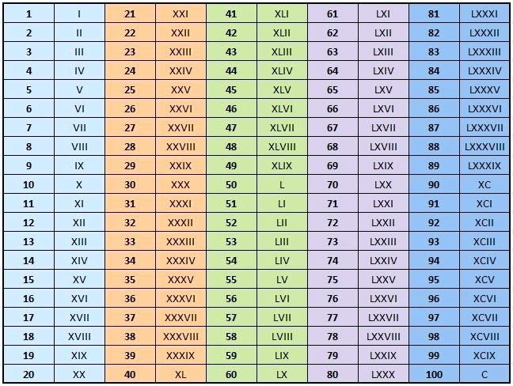

Slide 4
MAIN NUMBERS
50 = L 800 = DCCC
90 = XC 900 = CM
100 = C 1000 = M
200 = CC 1100 = MC
300 = CCC
400 = CD
500 = D
600 = DC
700 = DCC

Slide 5
CONVERT INTO ROMAN NUMERAL
456 = CDLVI
763 = DCCLXIII
946 = CMXLVI
895 = DCCCXCV
1275 = MCCLXXV
339 = CCCXXXIX
692 = DCXCII

Slide 6
ACTIVITY 2
WRITE IN ROMAN NUMERALS
95 - XCV 579 -DLXXIX
130 - CXXX 1038 -MXXXVIII
163 - CLXIII 1256 - MCCLVI
212 - CCXII
289 - CCLXXXIX
334 - CCCXXXIV
467 - CDLXVII

Slide 7
WRITE IN HINDU ARABIC
XLIII - 43 DXIII - 513
LXIX -69 MDXXV - 1525
CXXXV -135 DCCLXII -762
CLXII -162
CXC - 190
CCXXII -222
CCLXXXII -282

