Slide 1
Paragon Convent School
Class – 1
Subject- Maths
TOPIC – Ascending and Descending Order

Slide 2
ASCENDING ORDER
Ascending order means arranging numbers from the smallest to the greatest number.
Ex. 4, 7, 3, 1, 8
Ans. 1, 3, 4, 7, 8

Slide 3
DESCENDING ORDER
Descending order means arranging numbers from the greatest number to the smallest number.
Ex. 2, 6, 8, 9, 1
Ans. 9, 8, 6, 2, 1

Slide 4
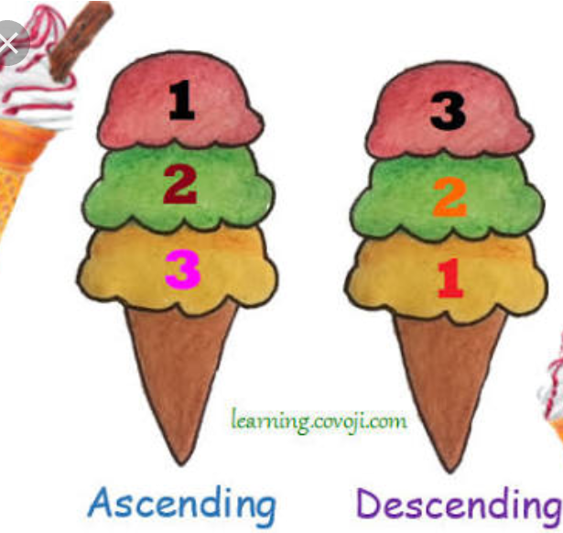

Slide 5
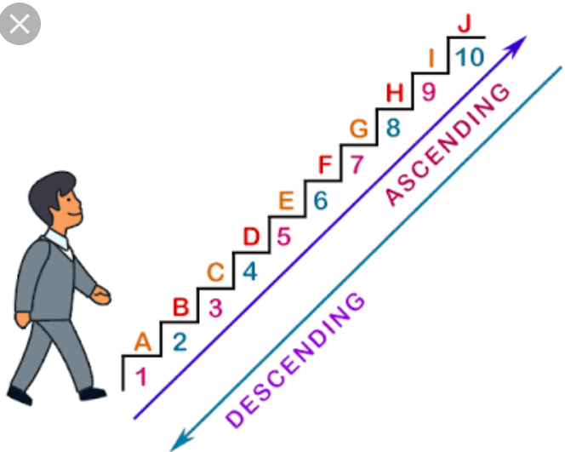

Slide 6
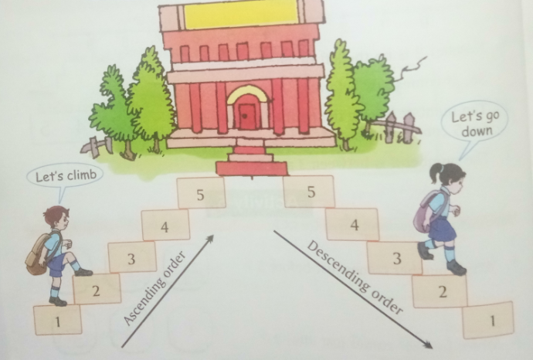

Slide 7
